Slide 1
iV. File input/output

Slide 2
File input/output
Input
Reading from a file
*do something*
Output
Writing to a file
1. Open 2. Read/write 3. Close

Slide 3
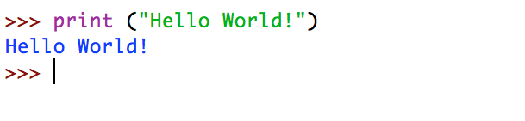
Print()
The simplest way to produce output is using the print statement.
print (“Hello World!”)

Slide 4
Escape sequences
Escape Sequence | Description | Example
\n | New line | >>> “hello\nworld” hello world
\t | Tab | >>> “hello\tworld” hello world
\\ \’ \” | Backslash Single quote(’) Double quote (”) | >>> ”\\hello\’world\”” \hello’world”

Slide 5
Input()
input (comment) – Reads a line from standard input and returns it as a string.
>>>input (“Enter input here : ”)
Enter input here: hello there
‘hello there’

Slide 6
Reading keyboard input
>>>str = input (“Enter input here : ”)
Enter input here: hello there
>>> print (“Input was:” + str)
Input was: hello there
>>> print (“Input was:”, str)
Input was: hello there
Stores input string as variable called str
User types input (example here is hello there)
We can print out the keyboard input (stored as variable str) by a print statement. Both print statements here give the same output.

Slide 7
1. Examples
>>>order = input (“What would you like eat? ”)
What would you like to eat? Cheeseburger and fries
>>> print (“One order placed for:” + order)
One order placed for: Cheeseburger and fries

Slide 8
Open()
f = open (file, mode) – Opens a file, usually stored to a variable f. Default mode set to r (reading) if no mode is inputted.
Mode | Description
‘r’ | Opens a file for reading only. The file pointer is placed at the beginning of the file. This is the default mode.
‘w’ | Opens a file for writing only. Overwrites the file if the file exists. If the file does not exist, creates a new file for writing.
‘a’ | Opens a file for appending. The file pointer is at the end of the file if the file exists. That is, the file is in the append mode. If the file does not exist, it creates a new file for writing.

Slide 9
Open()
>>> f = open (‘hello.txt’)
>>> f = open (‘hello.txt’, ‘r’)
>>> f = open (‘/files/test.txt’, ‘w’)

Slide 10
File functions
Function | Description
f.closed | Returns true if file is closed
f.name | Returns file name
f.mode | Returns file mode (r, w, b etc.)

Slide 11
Read()
f.read (characters) – Reads a string from the beginning of an open text file.
Passed parameter is the number of characters to be read from the opened file.
If no parameter is passed, it will read as many characters as possible/the whole file.

Slide 12
read()
>>> f.read(10)
‘This is th’
>>> f.read()
‘e entire file in this example\n’
>>> f.read()
‘’

Slide 13
Readline()
f.readline () – Reads the next line within the file.

Slide 14
readline()
>>> f.readline()
‘This is the first line of the file\n’
>>> f.readline()
‘This is second line of the file\n’

Slide 15
Readlines()
f.readlines () – returns all lines in file as a list.

Slide 16
readlines()
>>> f.readlines()
[‘This is the first line of the file\n’, ‘This is second line of the file\n’]

Slide 17
Reading lines
for line in f:
```do something```
Commonly, you can store each line of a file into a new object, such as a list. Or you could simply print each line in the file.

Slide 18
Reading lines
myList = []
for line in f:
print line
myList.append(line)

Slide 19
Write()
fileObject.write(string) – writes a string to an open file object.
The file object must be on writing mode (w).
This will overwrite the contents in the file.

Slide 20
Write()
f.write(“hello\nworld”)
Now if you open the file related to f, it will have the following content:
hello
world

Slide 21
Method | Description
f.seek(position) | Sets position (# of characters from the start) within file
f.tell() | Returns current position (# of characters from the start) within file

Slide 22
CLOSE()
f.close() - flushes any unwritten information and closes the file object, after which no more writing can be done.

Slide 23
Putting it all together
f = open(fileName, mode)
```read functions```
```write functions```
f.close()

Slide 24
Content managers
with open (fileName, mode) as f:
```do something```
Better formatting.
Doesn’t require one to manually close a file after opening.

Slide 25
Example (text file)
with open (‘test.txt’, ‘r’) as rf:
with open (‘test_copy.txt’, ‘w’) as wf:
for line in rf:
wf.write(line)

Slide 26
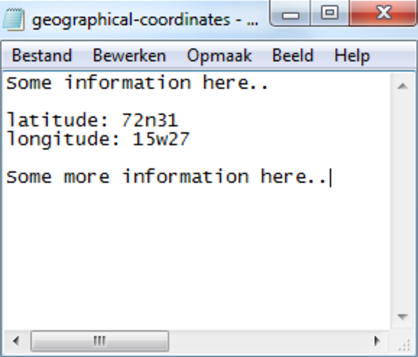

Text vs binary

Slide 27
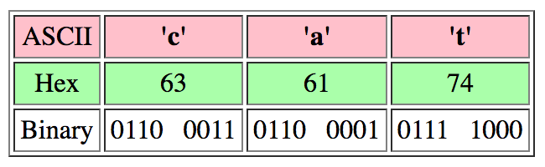
Text vs binary
Text (ASCII) files are special binary files.

Slide 28
Text vs binary
f = open (file, mode) – Opens a file, usually stored to a variable f. Default mode set to r (reading) if no mode is inputted.
Mode | ASCII/Text | Binary
reading | ‘r’ | ‘rb’
writing | ‘w’ | ‘wb’
appending | ‘a’ | ‘ab’

Slide 29
Example (binary file)
with open (‘test.jpg’, ‘rb’) as rf:
with open (‘test_copy.jpg’, ‘wb’) as wf:
for line in rf:
wf.write(line)

